Slide 1
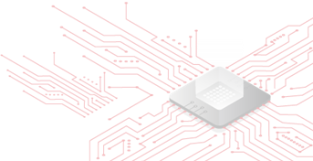
High-Throughput AES-128 Co-Processor for Industrial IoT
Presented By: Digital IC Design Team At Obour Engineering
Names:
Abdulrahman Ali Nasr
Farah Ahmed
Abdulrahman Mohamed
Abanoub Sabry
Ramadan Mohamed
Omar Atef
Under supervision of:
Assoc Prof. Saad El-Sayed

Slide 2

The Evolution of Hardware Security
Historical Overview:
1970s (DES): Focus on data confidentiality (Banking/Military).
2000s (AES): Focus on speed and internet security.
2020s (IoT): Focus on Physical Safety and Real-Time Control.
The Paradigm Shift: The "Pager Attack" (2024):
Recent events involving exploding communication devices demonstrated a Supply Chain Interdiction.
The VLSI Lesson: Software encryption cannot protect against physical hardware compromise.
Our Focus: This project addresses the need for Trusted Silicon—moving security from vulnerable software layers down to the immutable hardware level.

Slide 3
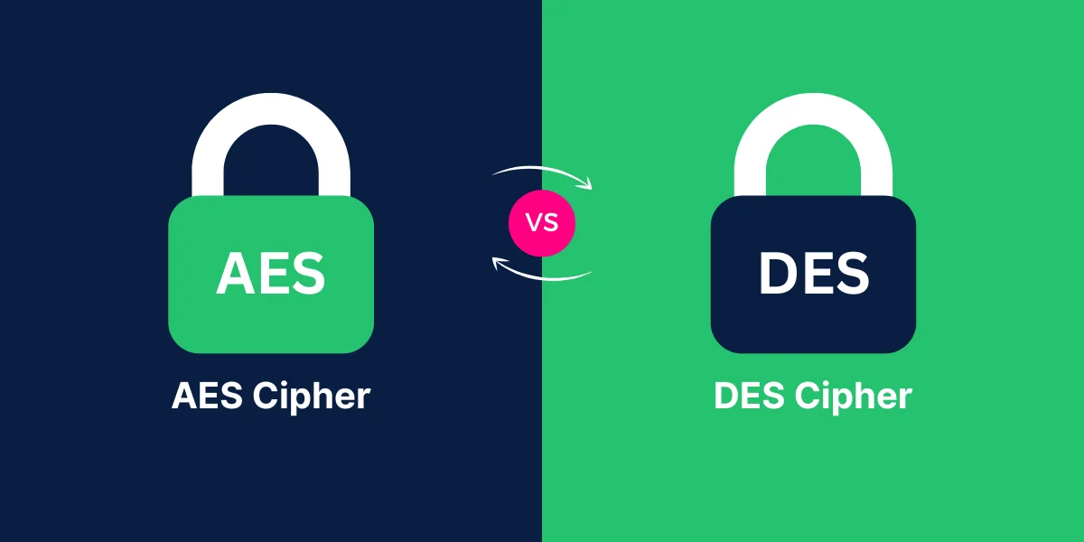
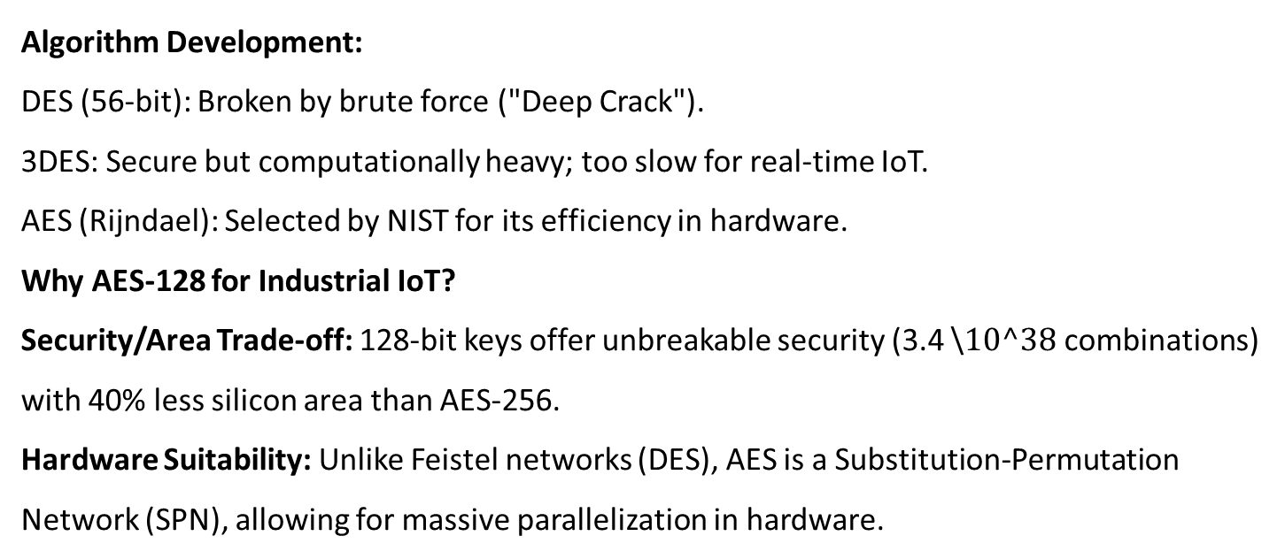
Algorithms & Why AES-128?
Algorithm Development:
DES (56-bit): Broken by brute force ("Deep Crack").
3DES: Secure but computationally heavy; too slow for real-time IoT.
AES (Rijndael): Selected by NIST for its efficiency in hardware.
Why AES-128 for Industrial IoT?
Security/Area Trade-off: 128-bit keys offer unbreakable security (3.4 \$10^38$ combinations) with 40% less silicon area than AES-256.
Hardware Suitability: Unlike Feistel networks (DES), AES is a Substitution-Permutation Network (SPN), allowing for massive parallelization in hardware.

Slide 4


Project Goals & Target Specifications
Target Application: Industrial IoT (IIoT) Edge Gateways.
Key Objectives:
Eliminate Bottlenecks: Offload encryption from the main CPU to dedicated silicon.
Deterministic Timing: Ensure fixed latency for real-time control loops.
Technical Specifications:
Throughput: > 12.8 Gbps (Targeting 10GbE Aggregation).
Latency: Fixed 5 Clock Cycles (50ns @ 100MHz).
Clock Frequency: 100 MHz (Conservative) / 150 MHz (Aggressive).

Slide 5
Project Phases
Architectural Design (Completed): Defined the 5-stage spatial pipeline and mathematical models for S-Boxes.
RTL Implementation (Current): Verilog-2001 coding of the datapath and key expansion units.
Verification (In Progress): UVM testbench for functional correctness and corner cases.
FPGA Prototyping: Synthesis and timing analysis on Artix-7/Cyclone V.
ASIC Backend: Synthesis, Floorplanning, and GDSII generation.

Slide 6
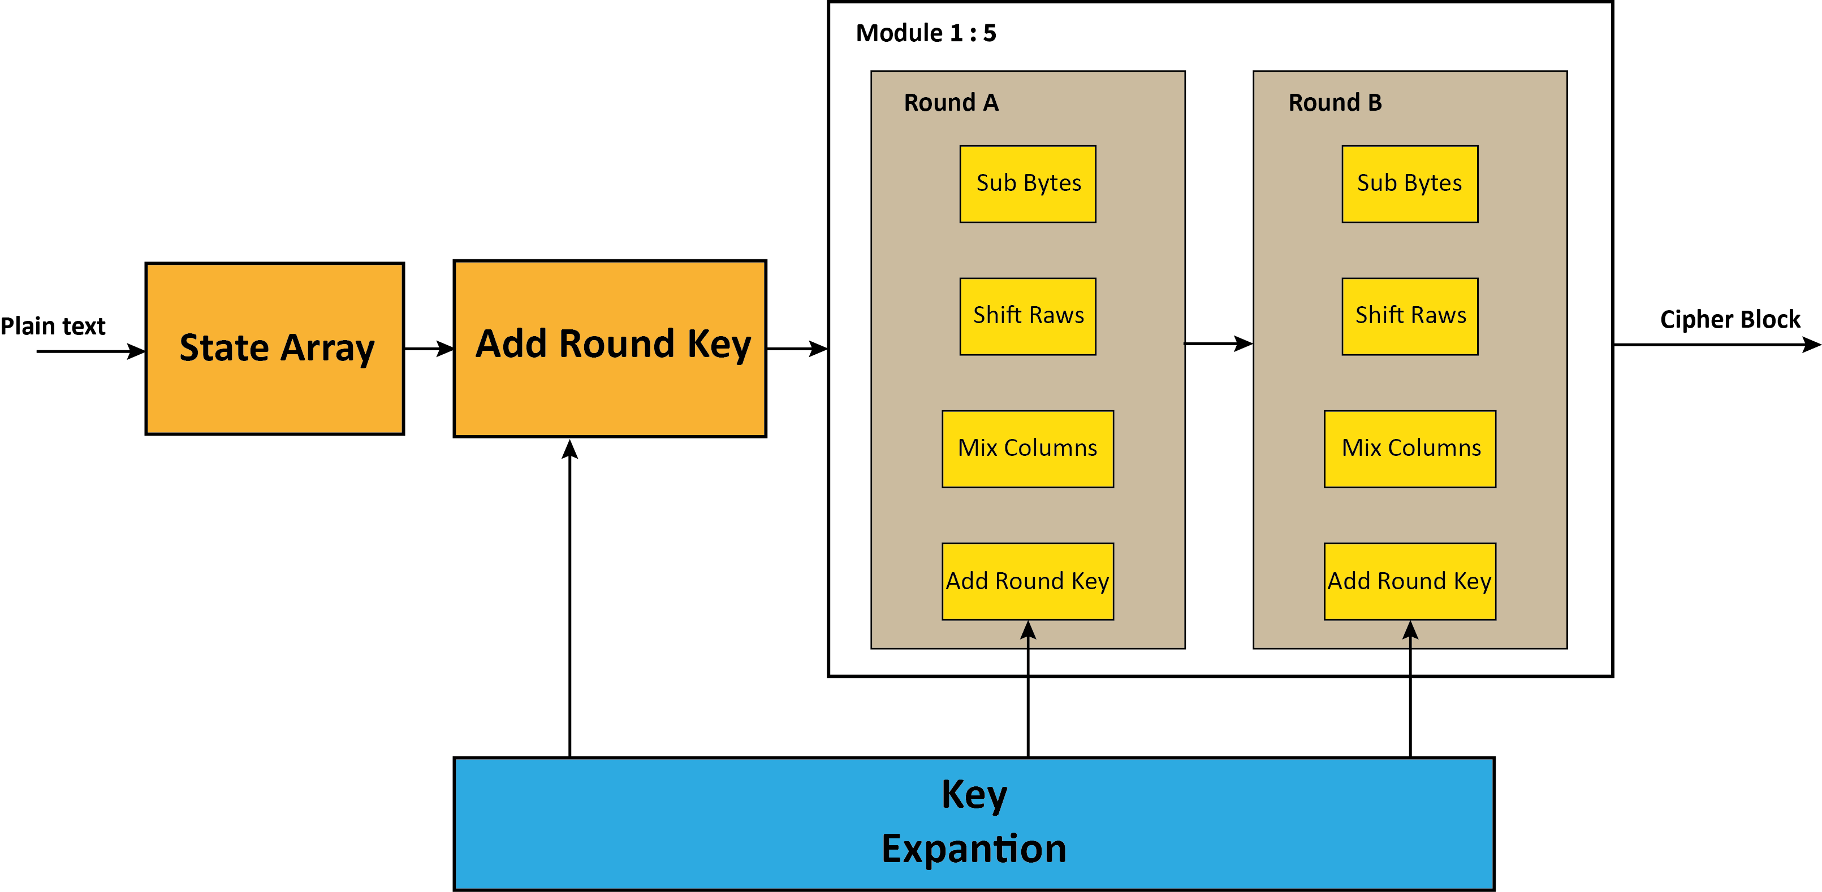
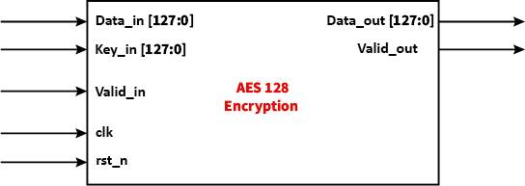
Block Diagram
System Level Implementation
5-Stage Unrolled Pipeline: Processes 2 Rounds per Clock Cycle to balance throughput vs. register overhead.
Feed-Forward Architecture: Data flows unidirectionally, eliminating complex feedback control logic and simplifying timing closure.

Slide 7
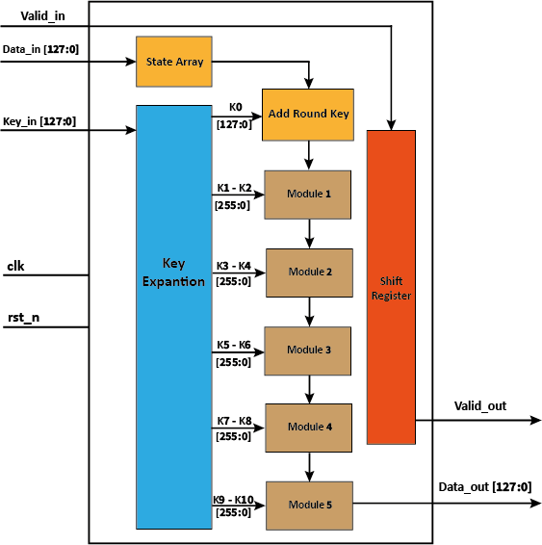
System Level Architecture
The system is divided into three functional domains:
Key Schedule Domain
Data Processing Domain
Control & Synchronization (shadow Data Path)
Clock Cycle | Stage 1 (R1+R2) | Stage 2 (R3+R4) | Stage 3 (R5+R6) | Stage 4 (R7+R8) | Stage 5 (R9+R10) | Output Valid?
Cycle 1 | Data A | (Empty) | (Empty) | (Empty) | (Empty) | 0 (Wait)
Cycle 2 | Data B | Data A | (Empty) | (Empty) | (Empty) | 0 (Wait)
Cycle 3 | Data C | Data B | Data A | (Empty) | (Empty) | 0 (Wait)
Cycle 4 | Data D | Data C | Data B | Data A | (Empty) | 0 (Wait)
Cycle 5 | Data E | Data D | Data C | Data B | Data A | 1 (Data A Ready!)
Cycle 6 | Data F | Data E | Data D | Data C | Data B | 1 (Data B Ready!)

Slide 8
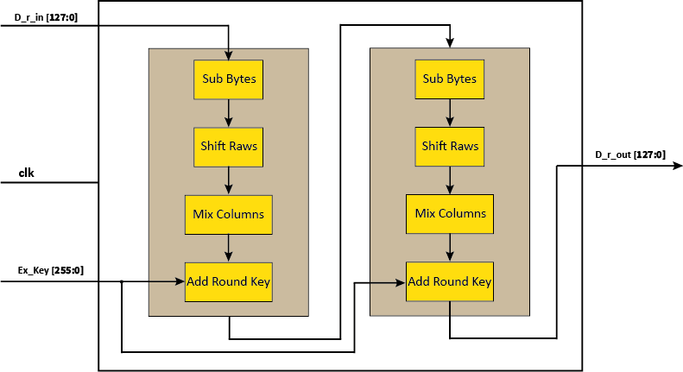
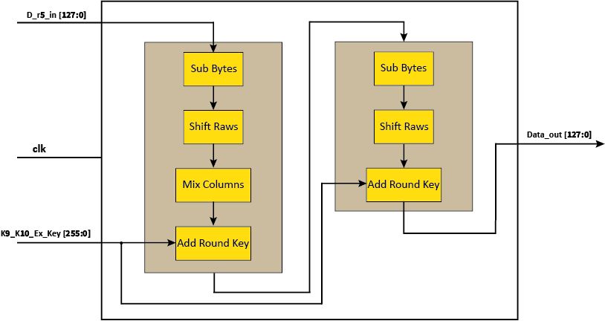
System Level Architecture

Slide 9
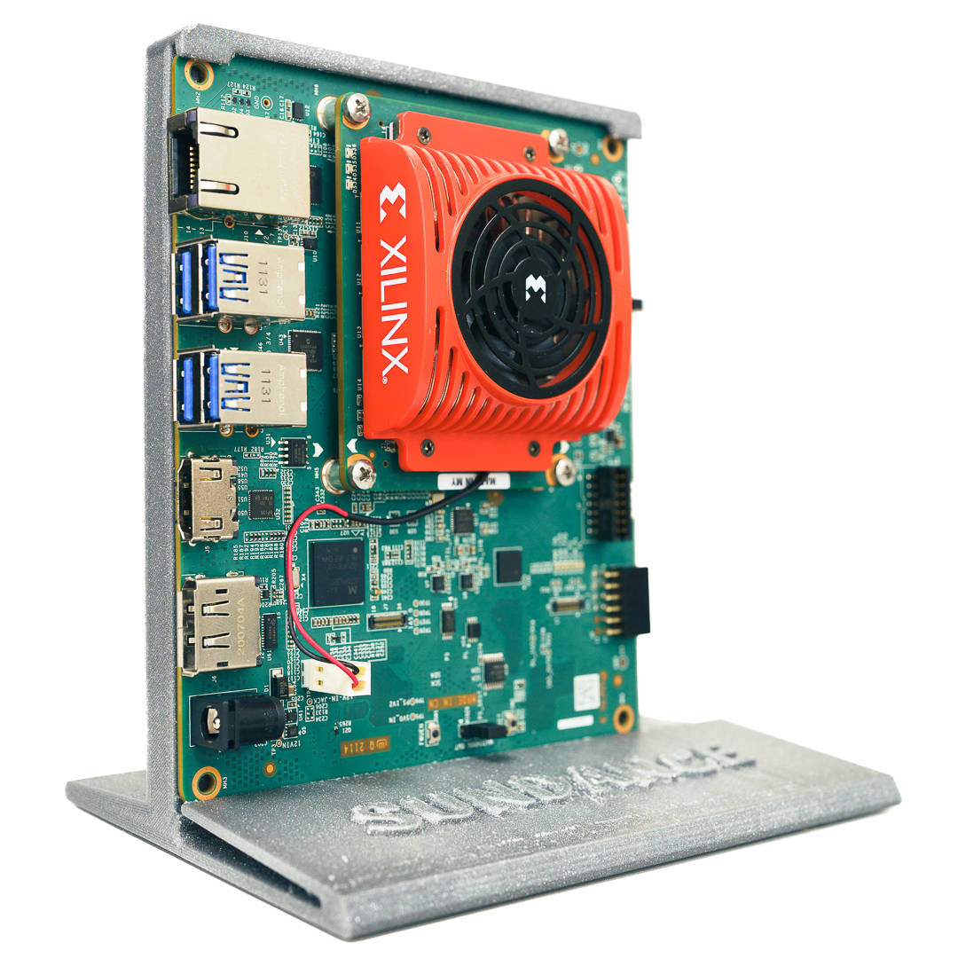
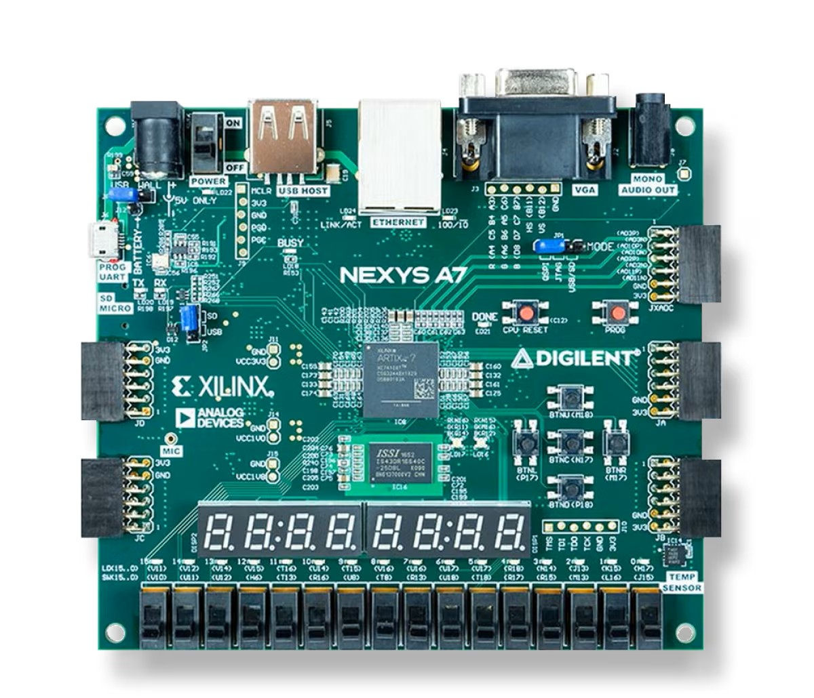
FPGA & Demo Implementation
Hardware Platforms & Rationale:
AMD Kria KV260 (Vision AI Starter Kit).
Architecture: Zynq UltraScale+ MPSoC (ARM Cortex-A53 + FPGA Fabric).
Nexys A7 (Artix-7 XC7A100T):
Architecture: Pure FPGA fabric (28nm).

Slide 10
Verification Strategy (UVM & SCA)
Functional Verification (UVM):
Driver: Saturates the pipeline with back-to-back transactions (100% utilization).
Scoreboard: Bit-exact comparison against a C-Model Golden Reference.
Security Verification (Side-Channel Analysis):
Goal: Verify resistance to Power Analysis Attacks (DPA/CPA).

Slide 11
ASIC Flow
From RTL to GDSII.

Slide 12
Conclusion
Summary: We are developing a high-performance AES core that addresses the specific speed and security needs of the Industrial IoT.
Key Advantage: By moving from memory-based to logic-based arithmetic, we optimize for the physical realities of modern silicon—reducing area.
Next Steps: Proceeding to FPGA synthesis and preparing the netlist for physical design.

Slide 13
Mentorship Request
Analog/Mixed-Signal Insight: Advice on Power Grid Integrity and decoupling capacitor placement to handle switching noise.
Guidance on setting up a Power Simulation Testbench to validate our Side-Channel security claims.
Design Review: Critical feedback on our pipeline depth and logic optimization strategies.

